Slide 1


Slide 2
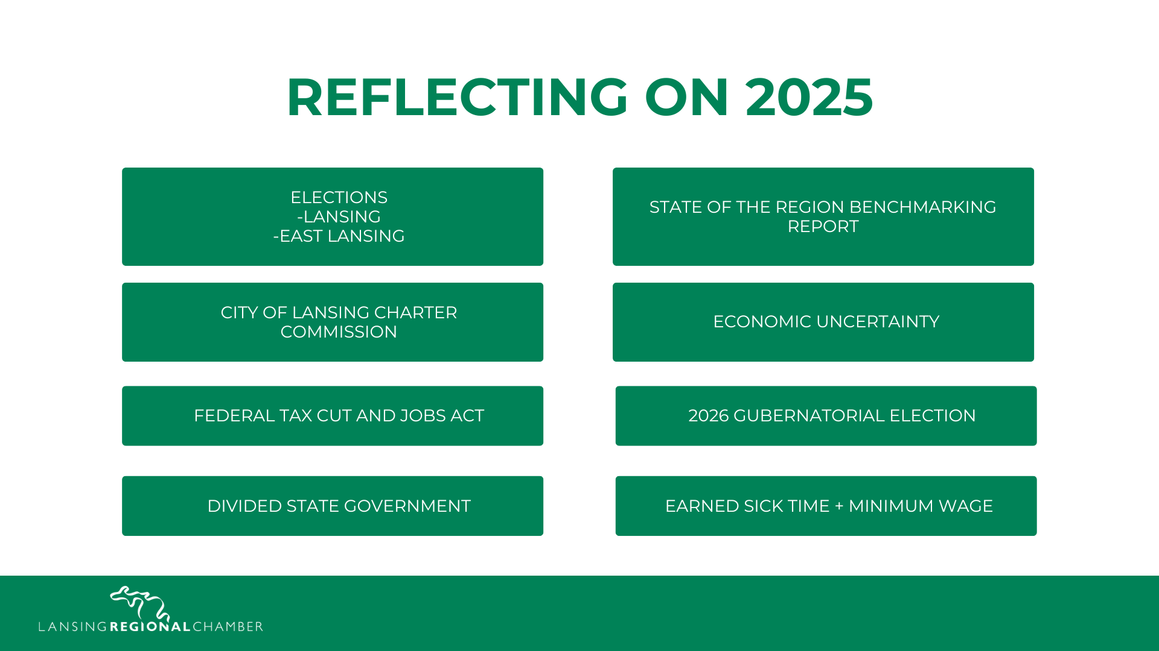

Slide 3
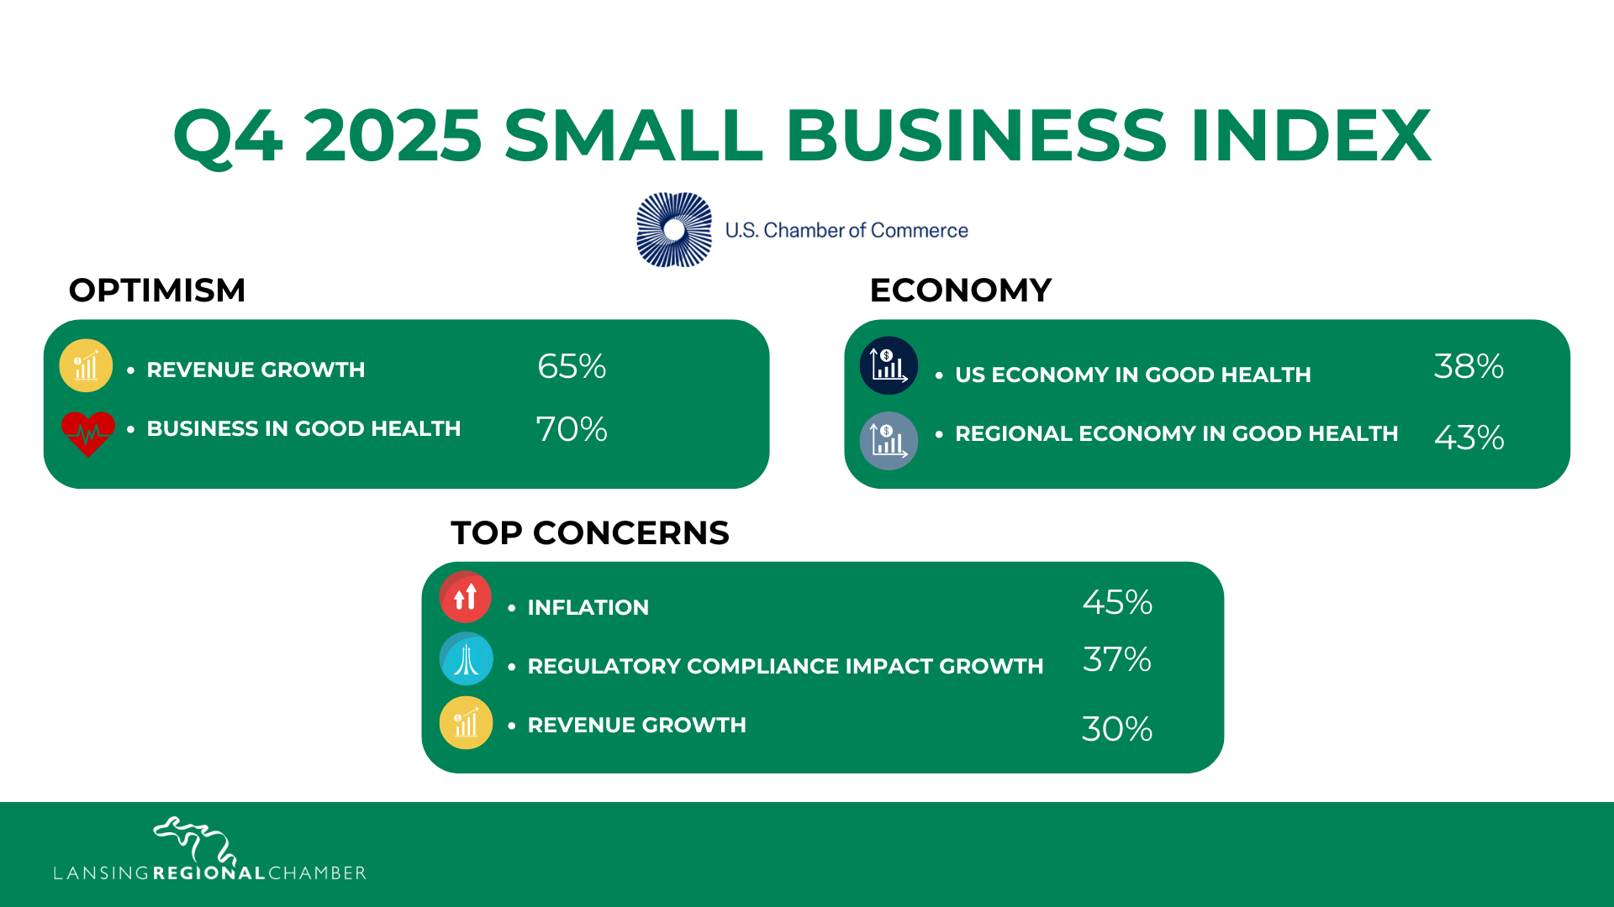

Slide 4


Slide 5
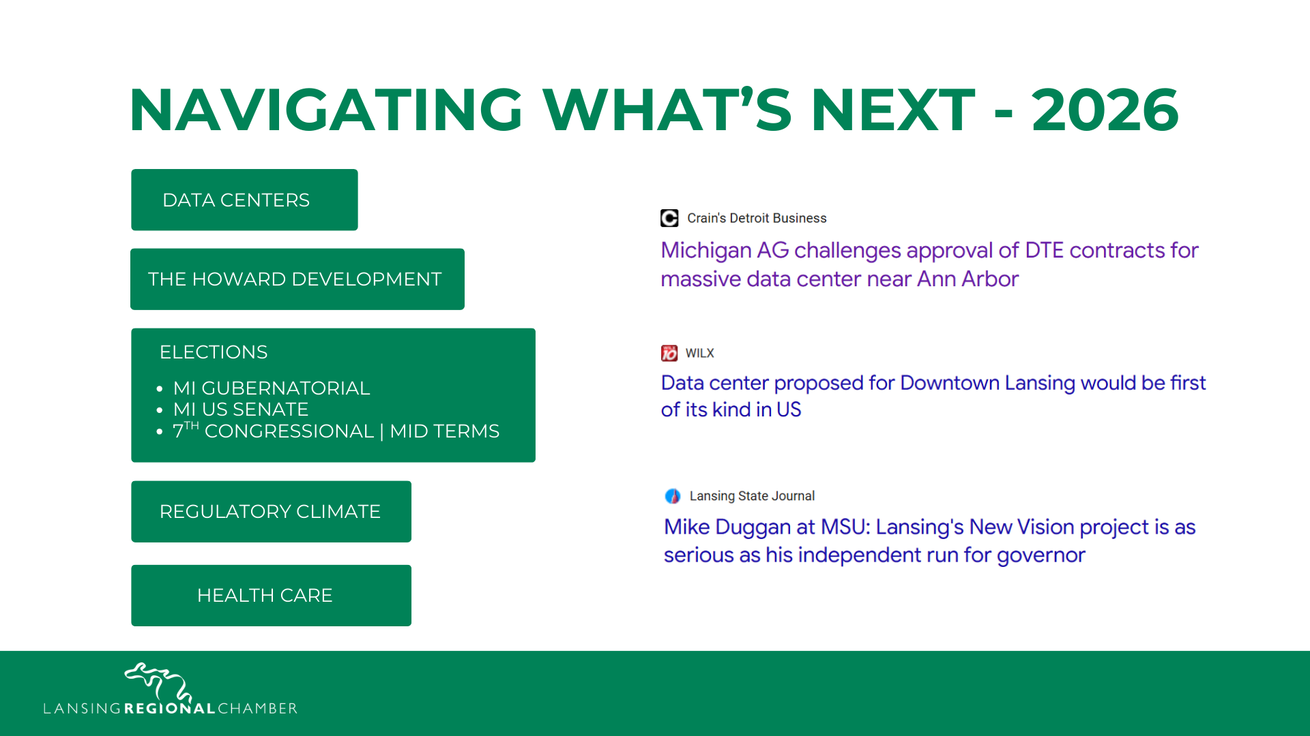

Slide 6



125 YEARS OF LEADERSHIP

Slide 7


